Slide 1
Progress on a performance framework for Chinese Medicine in Australia
Dr David Graham

Slide 2
Elements of a medical system
Rational use by users
Product quality and safety
Product efficacy
Clinical practice including guidelines
Education & training of practitioners
Innovation and evidence base
Informatics

Slide 3
Achieving a quality medical system
Rational use by users
Product quality and safety
Product efficacy
Clinical practice including guidelines
Education & training of practitioners
Innovation and evidence base
Informatics
Registration of
Practitioners
Regulation of products
Standards, guidelines ………
Research and development

Slide 4
Performance framework
1. Research and development.
2. Standards, guidelines …….
3. Regulation of medicines and devices.
4. Registration of practitioners.

Slide 5
Research and Development
(the evidence base)
Rational use by users
Product Q & S
Product efficacy
Clinical practice including guidelines
Education & training of practitioners
Innovation and evidence base
Informatics
Registration of
Practitionerers
Regulation of products
Standards, guidelines ………
Research and development

Slide 6
A challenge
Previously largely traditional evidence,
but…
modernisation requires more scientific evidence.

Slide 7
Key Research Groups in CM in Australia
RMIT University: WHOCC, HIRi-TCM, CAIRCCM
University of Sydney: HMREC, I-TCM, JCTCM
University of Technology Sydney: ARCCIM
Western Sydney University: CompleMED, NICM
Other: Univ. of Adelaide, Melbourne University, Monash University
(Thankyou to Tony Zhang and Charlie Xue, RMIT, for information on R&D )

Slide 8
Key funding support in Australia
National Health & Medical Research Council (NHMRC).
ARC Linkage Grant.
Rural Industries Research and Development Corporation, Australian Government.
Universities and Faculties.
Industry support.
Overseas funding.

Slide 9
NHMRC support of TM research
“Since 2001 NHMRC has provided almost $69 million for rigorous scientific research in complementary medicine and alternative therapies”. – NHMRC website.
NHMRC Strategic Plan 2010-2012 identified ‘examining alternative therapy claims’ as a major health issue for consideration of research funding.
Separate data for research support on CAM is not available directly from NHMRC website after 2008

Slide 10
China-Australia International Research Centre for Chinese Medicine (RMIT University)
The Centre aims to:
investigate and evaluate the evidence base of TCM interventions for a range of disorders relevant to the ageing population and the current national and international priority areas
conduct clinical studies and systematic reviews to determine the efficacy and safety of TCM interventions
facilitate translation of clinical evidence into broader health care practice through publication of papers and monographs for continuing professional education
identify natural products that could potentially be developed into novel therapeutic agents
deepen international partnerships, extend research collaboration networks and build an identity as a centre of excellence in TCM and natural products research
provide training and support for emerging researchers and promote international exchange.

Slide 11
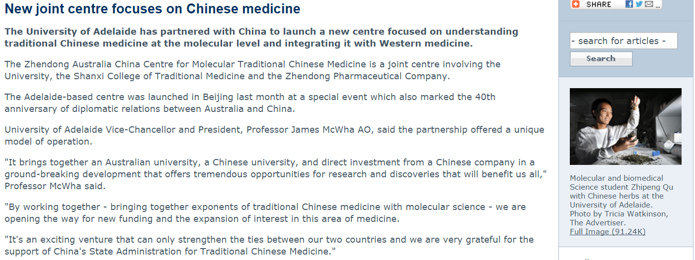
Zhendong Australia China Centre for Molecular TCM
(University of Adelaide)

Slide 12
National Institute of Complementary Medicine (NCIM)
(Western Sydney University)
Purpose of NCIM: Research on Complementary Medicine and translation of evidence into clinical practice and policy.
International agreements with:
Beijing University of Chinese Medicine
China Academy of Chinese Medicine Sciences
Guangzhou Pharmaceutical Holdings Ltd
Sun Yat-Sen University
School of Chinese Medicine, University of Hong Kong
Xiyuan Hospital

Slide 13
Overview of acupuncture research in Australia
1. Randomised controlled trials
Allergic rhinitis, headache, migraine, obesity and chronic pain: RMIT Chinese Medicine Research Group and Griffith University;
Women’s health (University of Melbourne, University of New South Wales, Western Sydney University, University of Adelaide and RMIT University; etc.)
2. Trial registration: The Australian Therapeutic Goods Administration and the Australian New Zealand Clinical Trial Registry.
3. Reporting: follow the Consolidated Standards of Reporting Trials (CONSORT Statement) & Preferred Reporting Items for Systematic Reviews and Meta-Analyses (PRISMA) in international standard.
4. Cochrane Database of Systematic Reviews
A wide range of conditions such as depression, induction of labour, lateral elbow pain, shoulder pain, hay fever and fibromyalgia.

Slide 14
Overview of herbal medicine research in Australia
1. Randomised controlled trials
Allergic rhinitis, obesity, COPD, psoriasis and eczema: RMIT University
Dementia, IBS, (University of New South Wales, Western Sydney University etc.)
2. Trial registration: The Australian Therapeutic Goods Administration and the Australian New Zealand Clinical Trial Registry.
3. Reporting: follow the Consolidated Standards of Reporting Trials (CONSORT Statement) & Preferred Reporting Items for Systematic Reviews and Meta-Analyses (PRISMA) in international standard.
4. Cochrane Database of Systematic Reviews
A wide range of conditions such as hay fever, COPD, asthma, psoriasis, dementia, mild cognitive impairment, eczema, colorectal cancer.

Slide 15
Main points (R&D)
The research funding pool in Australia is quite small.
Increasing liaisons both nationally and internationally.
Increasing number of researchers being trained.
University research programs are quite new but growing.
Cochrane evidence is often supportive but more, well designed studies needed.

Slide 16
2. Standards, guidelines ………
(defining good practice)
Rational use by users
Product Q & S
Product efficacy
Clinical practice including guidelines
Education & training of practitioners
Innovation and evidence base
Informatics
Registration of
Practitionerers
Regulation of products
Standards, guidelines ………
Research and development

Slide 17

Using R & D outcomes
Involves collating knowledge derived from research and development to define acceptable quality, safety and efficacy of products and services.
R&D outcomes

Slide 18

Standards, guidelines…………….
Codes of GAP, GMP, GDP etc.
Clinical guidelines.
Standards.
Pharmacopoeias

Slide 19

Participation in developing International Standards
ISO/TC 249
Title: Traditional Chinese Medicine.
Scope: Standardization in the field of medical systems derived from ancient Chinese medicine which shall be able to share one common set of standards. Both traditional and modern aspects of these systems are covered.

Slide 20
The benefits of an International Standard
Underpins the international use and acceptable practice.
Assists global consistency, e.g. clinical practice, terminology, trade.
Protects the public and the reputation of the modality.
Assists acceptance and use of the health modality.
Supports integration within health care more generally.

Slide 21
Technical areas covered by ISO/TC 249
Rational use by users
Product quality and safety
Product efficacy
Clinical practice including guidelines
Education & training of practitioners
Innovation and evidence base
Informatics

Slide 22
Overall progress of ISO/TC 249 projects
Published | FDIS | DIS | CD | AWI | NP | NWIP
7 | 6 | 9 | 3 | 7 | 22 | 35*
WG1 | WG2 | WG3 | WG4 | WG5 | JWG1 | JWG6
14 | 7 | 3 | 8 | 4 | 4 | 7
*35 NWIPs are being reviewed by the Working Groups.

Slide 23
The first two books in the series on EB-CM

Slide 24
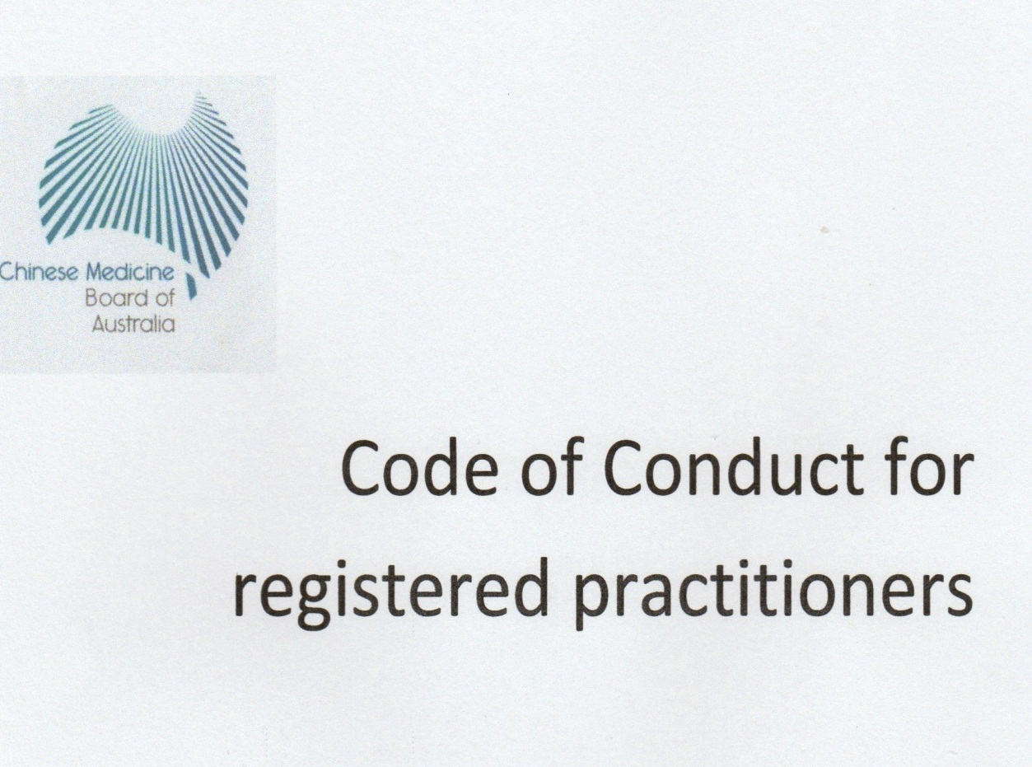
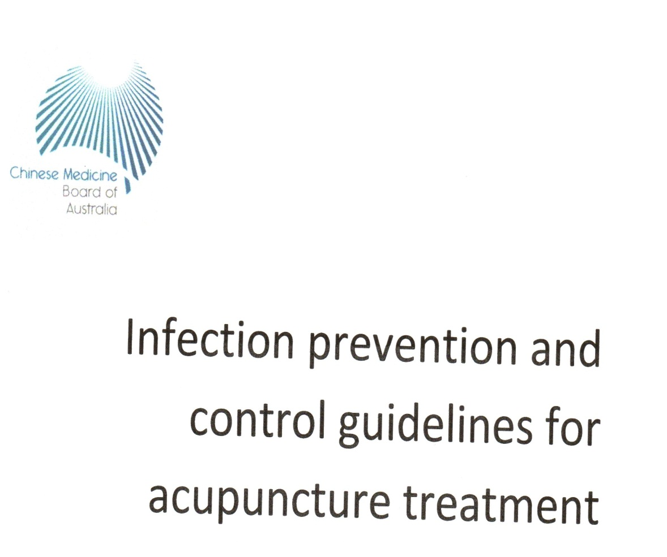
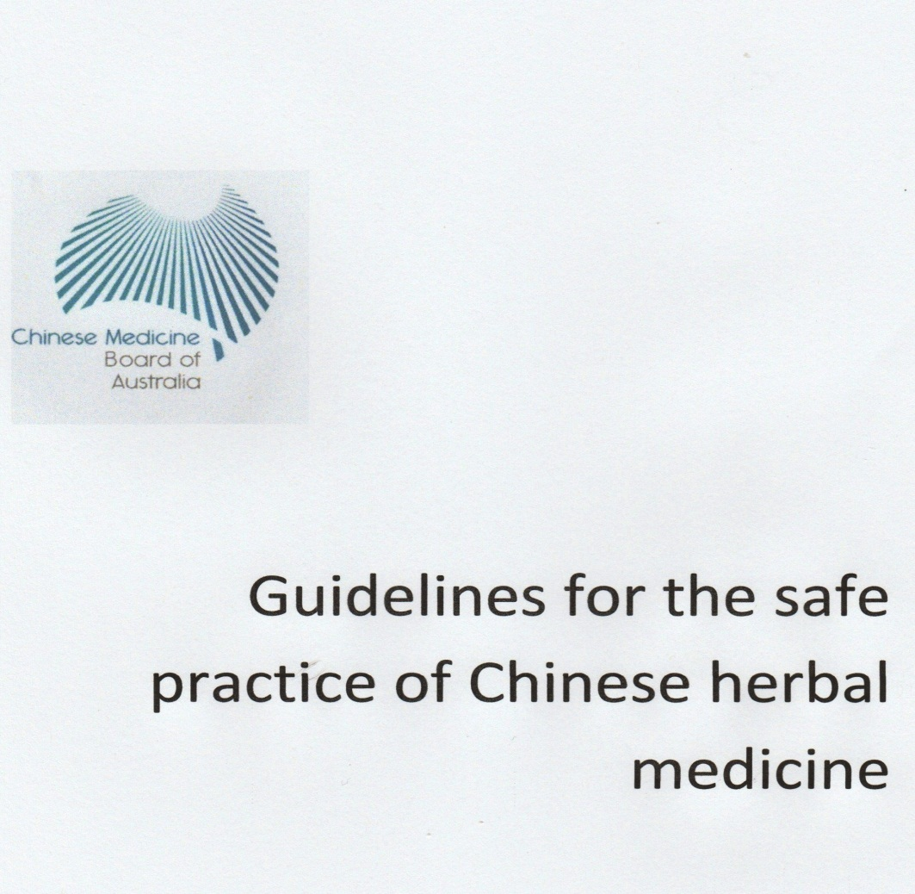

Slide 25
Main points (standards etc)
Relies on good R&D.
Based on consensus by a wide range of experts and other stakeholders.
Supports public safety and trade and commerce.
Under regular review and updating.

Slide 26
Regulation of Products (Therapeutic Goods Administration)
Rational use by users
Product Q & S
Product efficacy
Clinical practice including guidelines
Education & training of practitioners
Innovation and evidence base
Informatics
Registration of
Practitioners
Regulation of products
Standards, guidelines ………
Research and development

Slide 27
Key aspects
TCM has been included in therapeutic product regulation in Australia since 1990.
Primary aspects are quality, safety and efficacy of products.
Regulation is based on the level of risk to the public.
Respects consumers’ right of access.

Slide 28
Risk-managed regulation of medicines
Entry on Australian Register of Therapeutic Goods
High level
prescription medicines
High risk
registration
Low level
most OTC medicines
listing
many commercial alternative medicines and TM
contains
restricted
substances
sterile
preparations
intended for
substantial therapeutic
indications
Simple topical
pharmaceuticals,
exempt
Low risk
Individually made products

Slide 29
Risk-managed regulation of medicines
Entry on Australian Register of Therapeutic Goods
High level
prescription medicines
Premarket evaluation
GMP Licensing
Standards and testing
Post market monitoring
High risk
registration
Low level
most OTC medicines
many commercial
alternative
medicines and TM
Self assessment and TGA audit
listing
Simple topical
pharmaceuticals
exempt
Low risk
Individually made products

Slide 30
Supporting evidence of efficacy
 | Type | Method | Evidence
Prescription Medicine | Registered medicine | Independent evaluation of evidence | Scientific : RCT/ Meta analysis
OTC Medicine | Registered medicine | Use of approved active substance | Scientific
TM/CAM | Listed medicine | Self certification that suitable evidence held. Audit | Traditional and/or scientific
Individual patient medication | Exempt from Register | Informed consent by patient | Practitioner expertise (registration)
High risk
TM/CAM
Traditional and/or scientific
Low risk

Slide 31
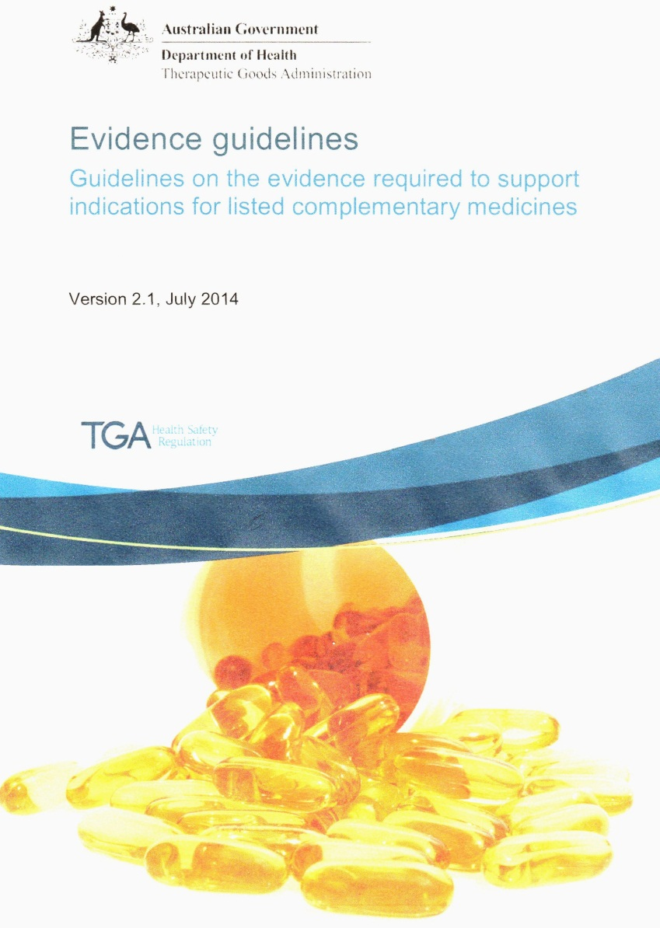
Requirements for accepting traditional evidence
Evidence that the medicine or ingredient has been used traditionally for at least 75 years.
Usually indicated uses are limited to statements of health benefit.
Product label includes e.g. ‘traditionally used in Chinese herbal medicine’.
Can have products with indications based on both scientific and traditional evidence.

Slide 32
Main points (products)
Chinese medicines are generally regulated as low risk products.
Commercial CM products can make health claims rather than claims of therapeutic effect.
Commercial products labels must indicate when claims are based on traditional use.
More substantial therapeutic claims must be supported by scientific evidence.
Individually prepared medicines for patients are exempt.
Post market monitoring: testing and adverse event reporting
Modernisation of CM increases the expectation by regulators for scientific evidence of efficacy.

Slide 33
4. Registration of Practitioners
(Chinese Medicine Board of Australia within the Australian Health Practitioners Regulation Agency)
Rational use by users
Product Q & S
Product efficacy
Clinical practice including guidelines
Education & training of practitioners
Innovation and evidence base
Informatics
Registration of
Practitioners
Regulation of products
Standards, guidelines ………
Research and development

Slide 34
Key principles
The national registration system for Chinese Medicine practitioners commenced in July 2012.
Its primary purpose is to protect public health and safety.
Competent and ethical practitioners are registered.
It aims at minimum regulatory force.
The legislation is based on the use of protected titles (e.g. acupuncturist, CM practitioner).

Slide 35
Key aspects of registration
Accredited bachelor degree programs of study.
Recognition of equivalent overseas qualifications.
Compliance required with certain standards (Criminal history, English proficiency, CPD, Indemnity insurance, Recency of practice).
3 Divisions: acupuncture, Chinese herbal medicine and Chinese herbal dispensing.
Notification mechanism for complaints about registered practitioners.

Slide 36
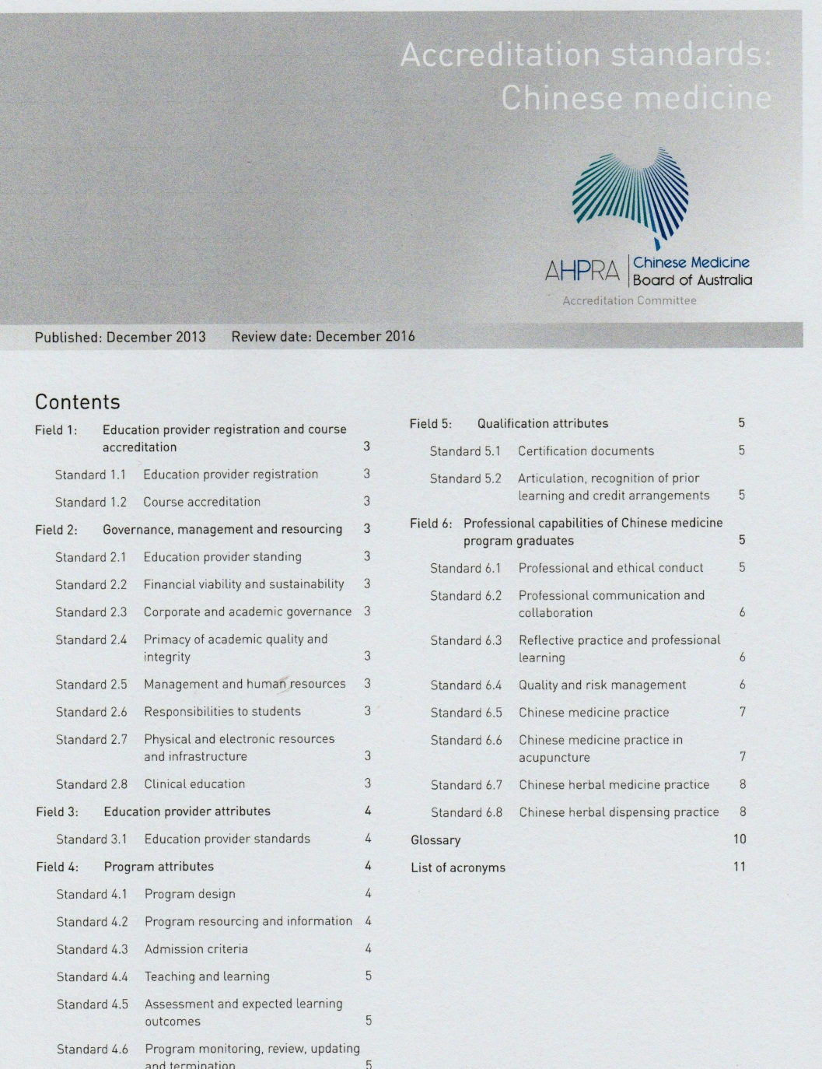
Accreditation of courses

Slide 37

Numbers registered in June 2016
Acupuncture 1722
Chinese herbal medicine 50
Chinese herbal dispensing 45
Regd. in 2 or 3 Divisions 2928
Other 17
Total 4762

Slide 38
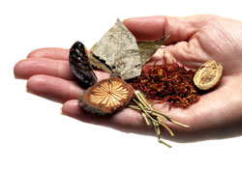
Registered practitioners
52.3% are female.
28% gained their initial qualification overseas.
95% work in community clinics.
There are no TCM hospitals in Australia.

Slide 39
Main points (practitioners)
CM practitioners are now registered on a similar basis to other health professions.
Competency is based on accredited programs of study or equivalent at the degree level.
Proficiency in English is required.
Practitioners cannot use some higher risk herbs.
No government subsidy for CM services but some funding via private health insurance.
Little integration as yet into the wider health system.

Slide 40

Main challenges
Progressing the evidence base: both traditional use and scientific evidence.
Soft boundaries around protected professional titles.
Achieving greater integration into the Australian healthcare system.

Slide 41
Thank you

